Slide 1

Cricket statistics
SQL Mini Project

Slide 2
CRICKET STATISTICS
Objective :-
Developing a Cricket Statistics Project using MYSQL , HTML , CSS, PHP for the Cricket Organization.
In which Cricket Organization need to Enter the information of Cricketer in the placeholder, after clicking on the Submit Button Cricketer information will be store on the Database.

Slide 3
Purpose of the Project :
Some time we want to store all the information about the cricket players but every time storing the information in Record Book is difficult so I have developed a mini Sql project in which cricket organization/we can store the information about cricketer in the Database.

Slide 4
Software requirement :-
Programming languages :- HTML , CSS , PHP , MySQL .
Compiler :- WebBrowser.
Application / Editor :- Visual Studio Code , Notepad

Slide 5
HTML tags used in the program :-
Heading (h1 to h6) :-
html headings are defined with he <h1> to <h6> tags.
<h1> defines the most important heading. <h6> defines the least important heading.
Paragraph(p) :- The HTML <p> element defines a paragraph.
A paragraph always starts on a new line, and browsers automatically add some white space (a margin) before and after a paragraph.

Slide 6
Img :-
The <img> tag is used to embed an image in an HTML page. Images are not technically inserted into a web page; images are linked to web pages.
Button :-
The <button> tag is used to create a clickable button within HTML form on your webpage.
Why we use <form action=""></form> in html ?
Answer :-
The action attribute specifies where to send the form-data when a form is submitted.

Slide 7
PHP Variable :-
$ :- The $ (single dollar) is the normal variable with the name x that stores any value like string, integer, float, etc.
$_POST :- is a PHP super global variable which is used to collect form data after submitting an HTML form with method="post".
$_POST is also widely used to pass variables.

Slide 8
USE OF CSS :-
CSS stands for Cascading Style Sheets .
CSS describes how HTML elements are to be displayed on screen, paper, or in other media .
CSS saves a lot of work. It can control the layout of multiple web pages all at once .
External stylesheets are stored in CSS files .

Slide 9
Steps for Connect MySql with HTML :-
For this you need to follow the following steps:
Step 1: Download and Install XAMPP Control Panel.
Step 2: Click to XAMPP and start the MySQL ,Click on the Admin.
Step 3: Create a database and a table in MySQL.
Step 4: Create HTML form for connecting to database.
Step 5: Create a PHP page to save data from HTML form to your MySQL database.
Step 6: All done!

Slide 10
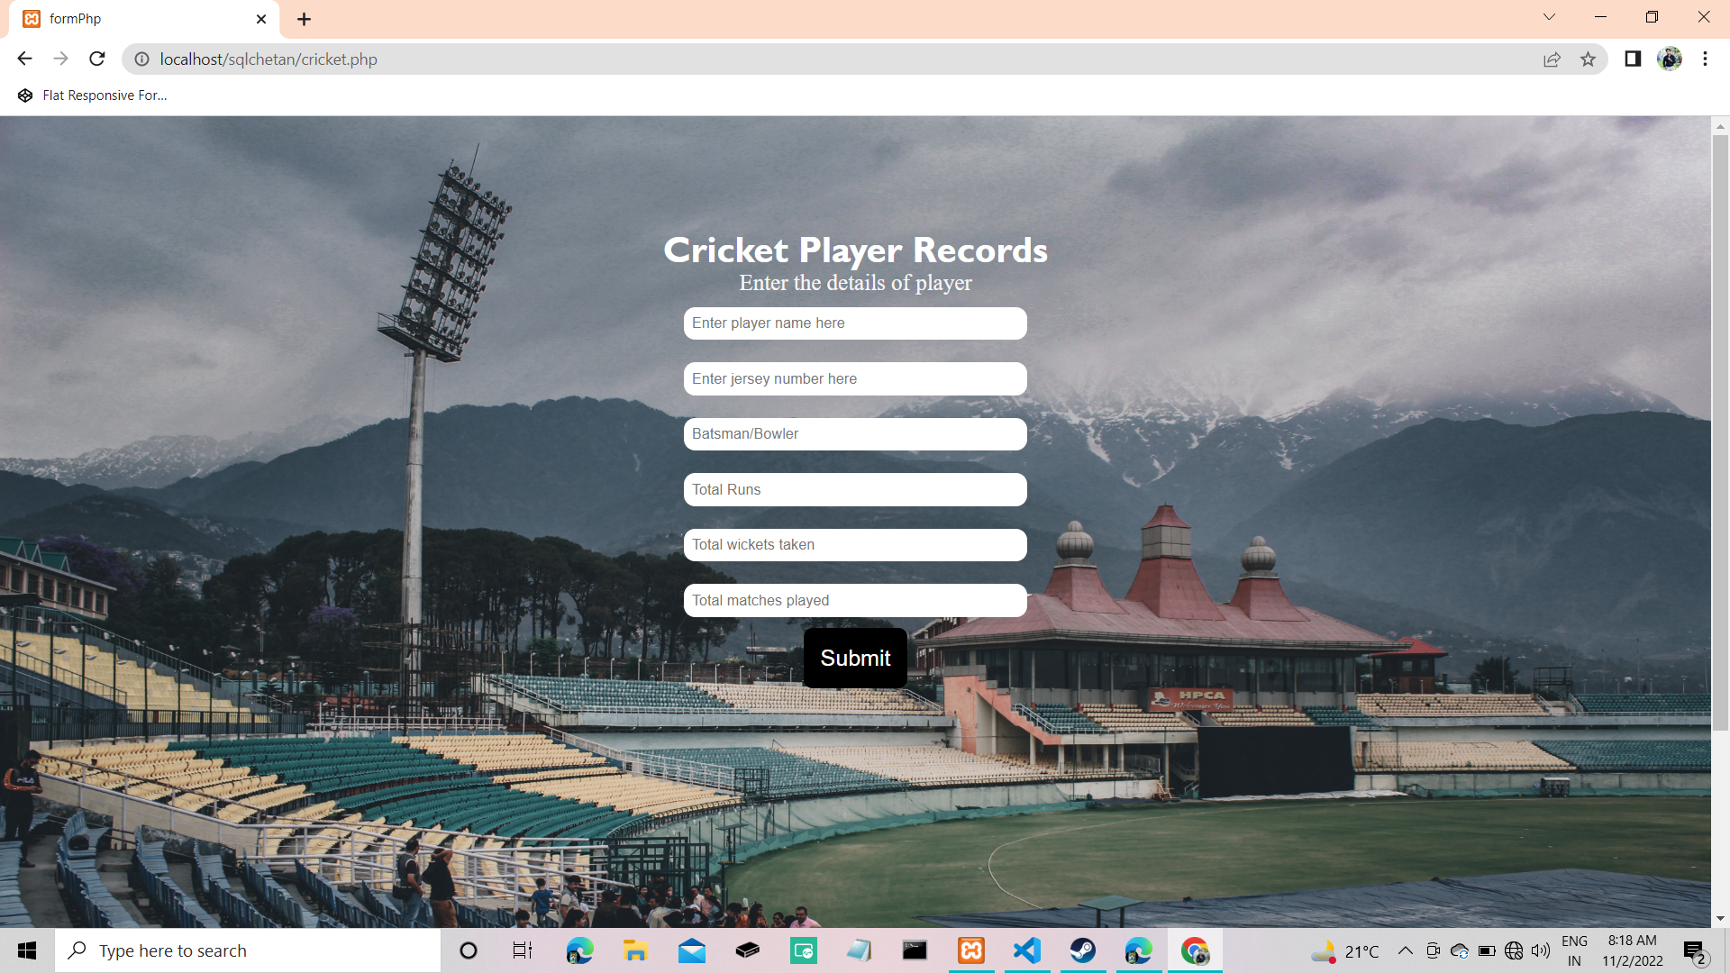
Interface of cricket statistic on WebBrowser: :-

Slide 11
Connectivity MySQL with HTML using PHP:-
<?php
$insert=false;
// $not_insert=false;
if(isset($_POST['name'])){
// set connection variables
$server = "localhost";
$username="root";
$password = "";
// create a database connection
$con = mysqli_connect($server,$username,$password);
// check for connection success
if(!$con)
{
die("connection to the database failed due to".mysqli_connect_error());
}
// echo "Success connecting to the db";
// collect post variables
$name = $_POST['name'];
$jersey_no = $_POST['jersey_no'];
$catagory = $_POST['catagory'];
$runs = $_POST['runs'];
$wickets = $_POST['wickets'];
$matches = $_POST['matches'];

Slide 12
// $dt = $_POST['dt'];
$sql = "INSERT INTO `cricket`.`record` (`name`, `jersey_no`, `catagory`, `runs`, `wickets`, `matches`) VALUES ('$name', '$jersey_no', '$catagory', '$runs', '$wickets', '$matches');";
// echo $sql;
//execute the query
if($con->query($sql)==true){
// flag for successful insertion
$insert=true;
// echo "successful submition";
}
else{
// $not_insert=true;
echo "ERROR: $sql <br> $con->error";
}
//close the database connection
$con->close();
}
?>

Slide 13
.html File :-
<!DOCTYPE html>
<html lang="en">
<head>
<meta charset="UTF-8">
<meta http-equiv="X-UA-Compatible" content="IE=edge">
<meta name="viewport" content="width=device-width, initial-scale=1.0">
<title>formPhp</title>
<link rel="stylesheet" href="design.css">
<style>
.doc{
background-color: rgb(112, 37, 169);
}
</style>
</head>
<body>
<img class="bg" src="std.jpg" alt="stadium">
<div class="con">
<h1 class="h1">Cricket Player Records</h1>
<p> Enter the details of player</p>

Slide 14
<?php
if($insert==true)
{
echo "<p class='submitMsg'>Details are recorded.<p/>";
}
?>
<form action="cricket.php" method="post">
<input type="text" name="name" id="name" placeholder="Enter player name here">
<input type="text" name="jersey_no" id="jersey_no" placeholder="Enter jersey number here">
<input type="text" name="catagory" id="catagory" placeholder="Batsman/Bowler">
<input type="text" name="runs" id="runs" placeholder="Total Runs">
<input type="text" name="wickets" id="wickets" placeholder="Total wickets taken">
<input type="text" name="matches" id="matches" placeholder="Total matches played">
<button class="btn">Submit</button>
</form>
</div>
</body>
</html>

Slide 15
.css file:-
*{
margin: 0px;
padding: 0px;
box-sizing: border-box;
}
.con{
max-width: 80%;
padding: 100px;
margin: 25px;
margin:auto;
text-align: center;
}
.h1{
text-align: center;
font-family: 'Gill Sans', 'Gill Sans MT', Calibri, 'Trebuchet MS', sans-serif;
color: white;
}

Slide 16
p{
color:whitesmoke;
text-align: center;
font-size: 20px;
}
input,textarea{
width: 30%;
margin: 10px auto;
padding: 5px;
font-size: 13px;
border: 2px solid white;
border-radius: 10px;
outline:none;
}
Form{
display: flex;
align-items: center;
justify-content: center;
flex-direction: column;
}

Slide 17
.btn{
color:white;
background-color: rgb(0, 0, 0);
padding: 10px 10px;
font-size: 20px;
border:5px solid rgb(0, 0, 0);
border-radius: 8px;
}
.bg{
width: 100%;
height:130% ;
position:absolute;
z-index: -1;
opacity: 1;
}
.submitMsg{
font-size: 25px;
color: rgb(255, 255, 255);
}

Slide 18
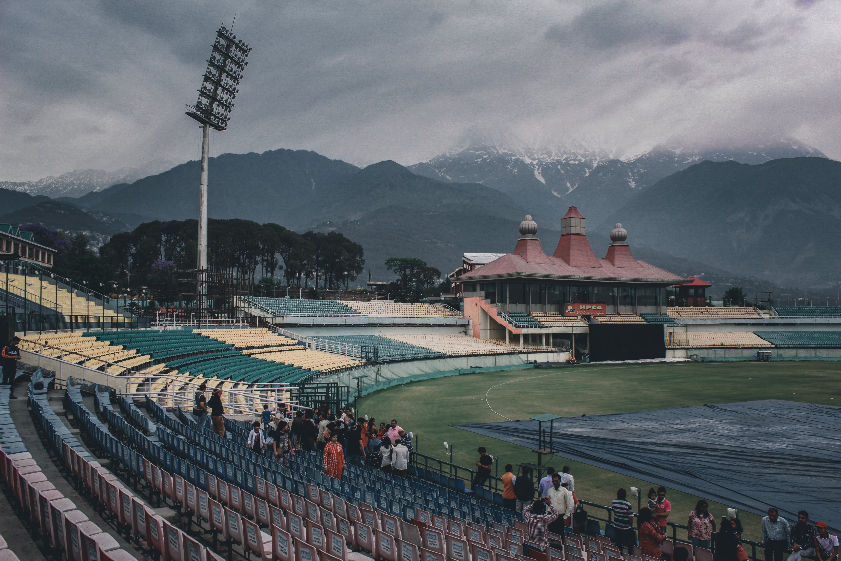
.jpg file which is added as background of the WebBrowser using HTML:-

Slide 19
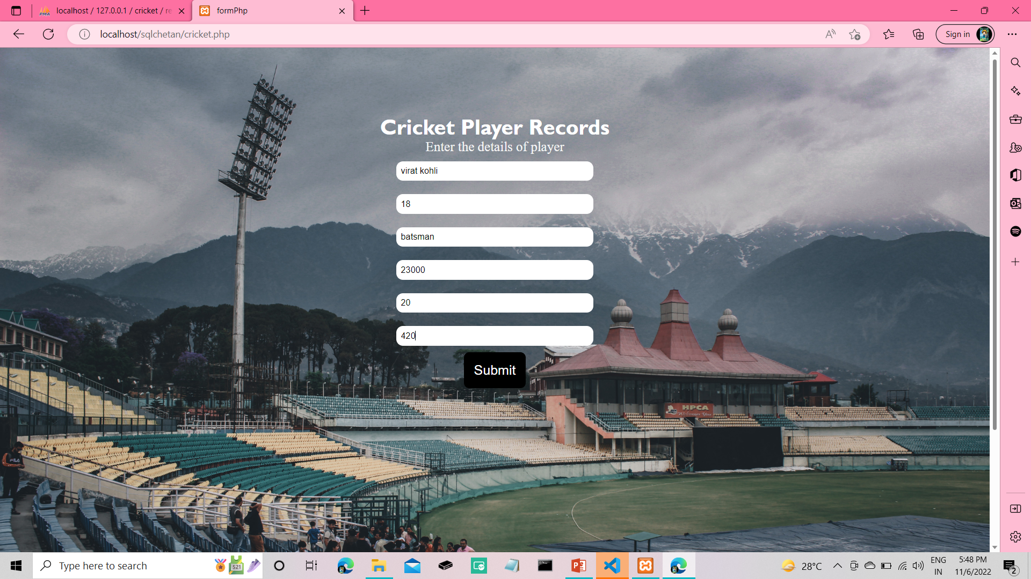
Inserting Cricketer information :

Slide 20
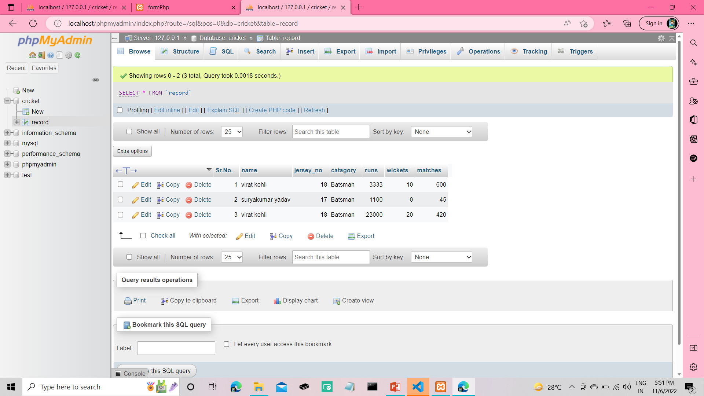
After Clicking on Submit Button information will be store on the Database.

Slide 21
THANK
YOU.

